Slide 1
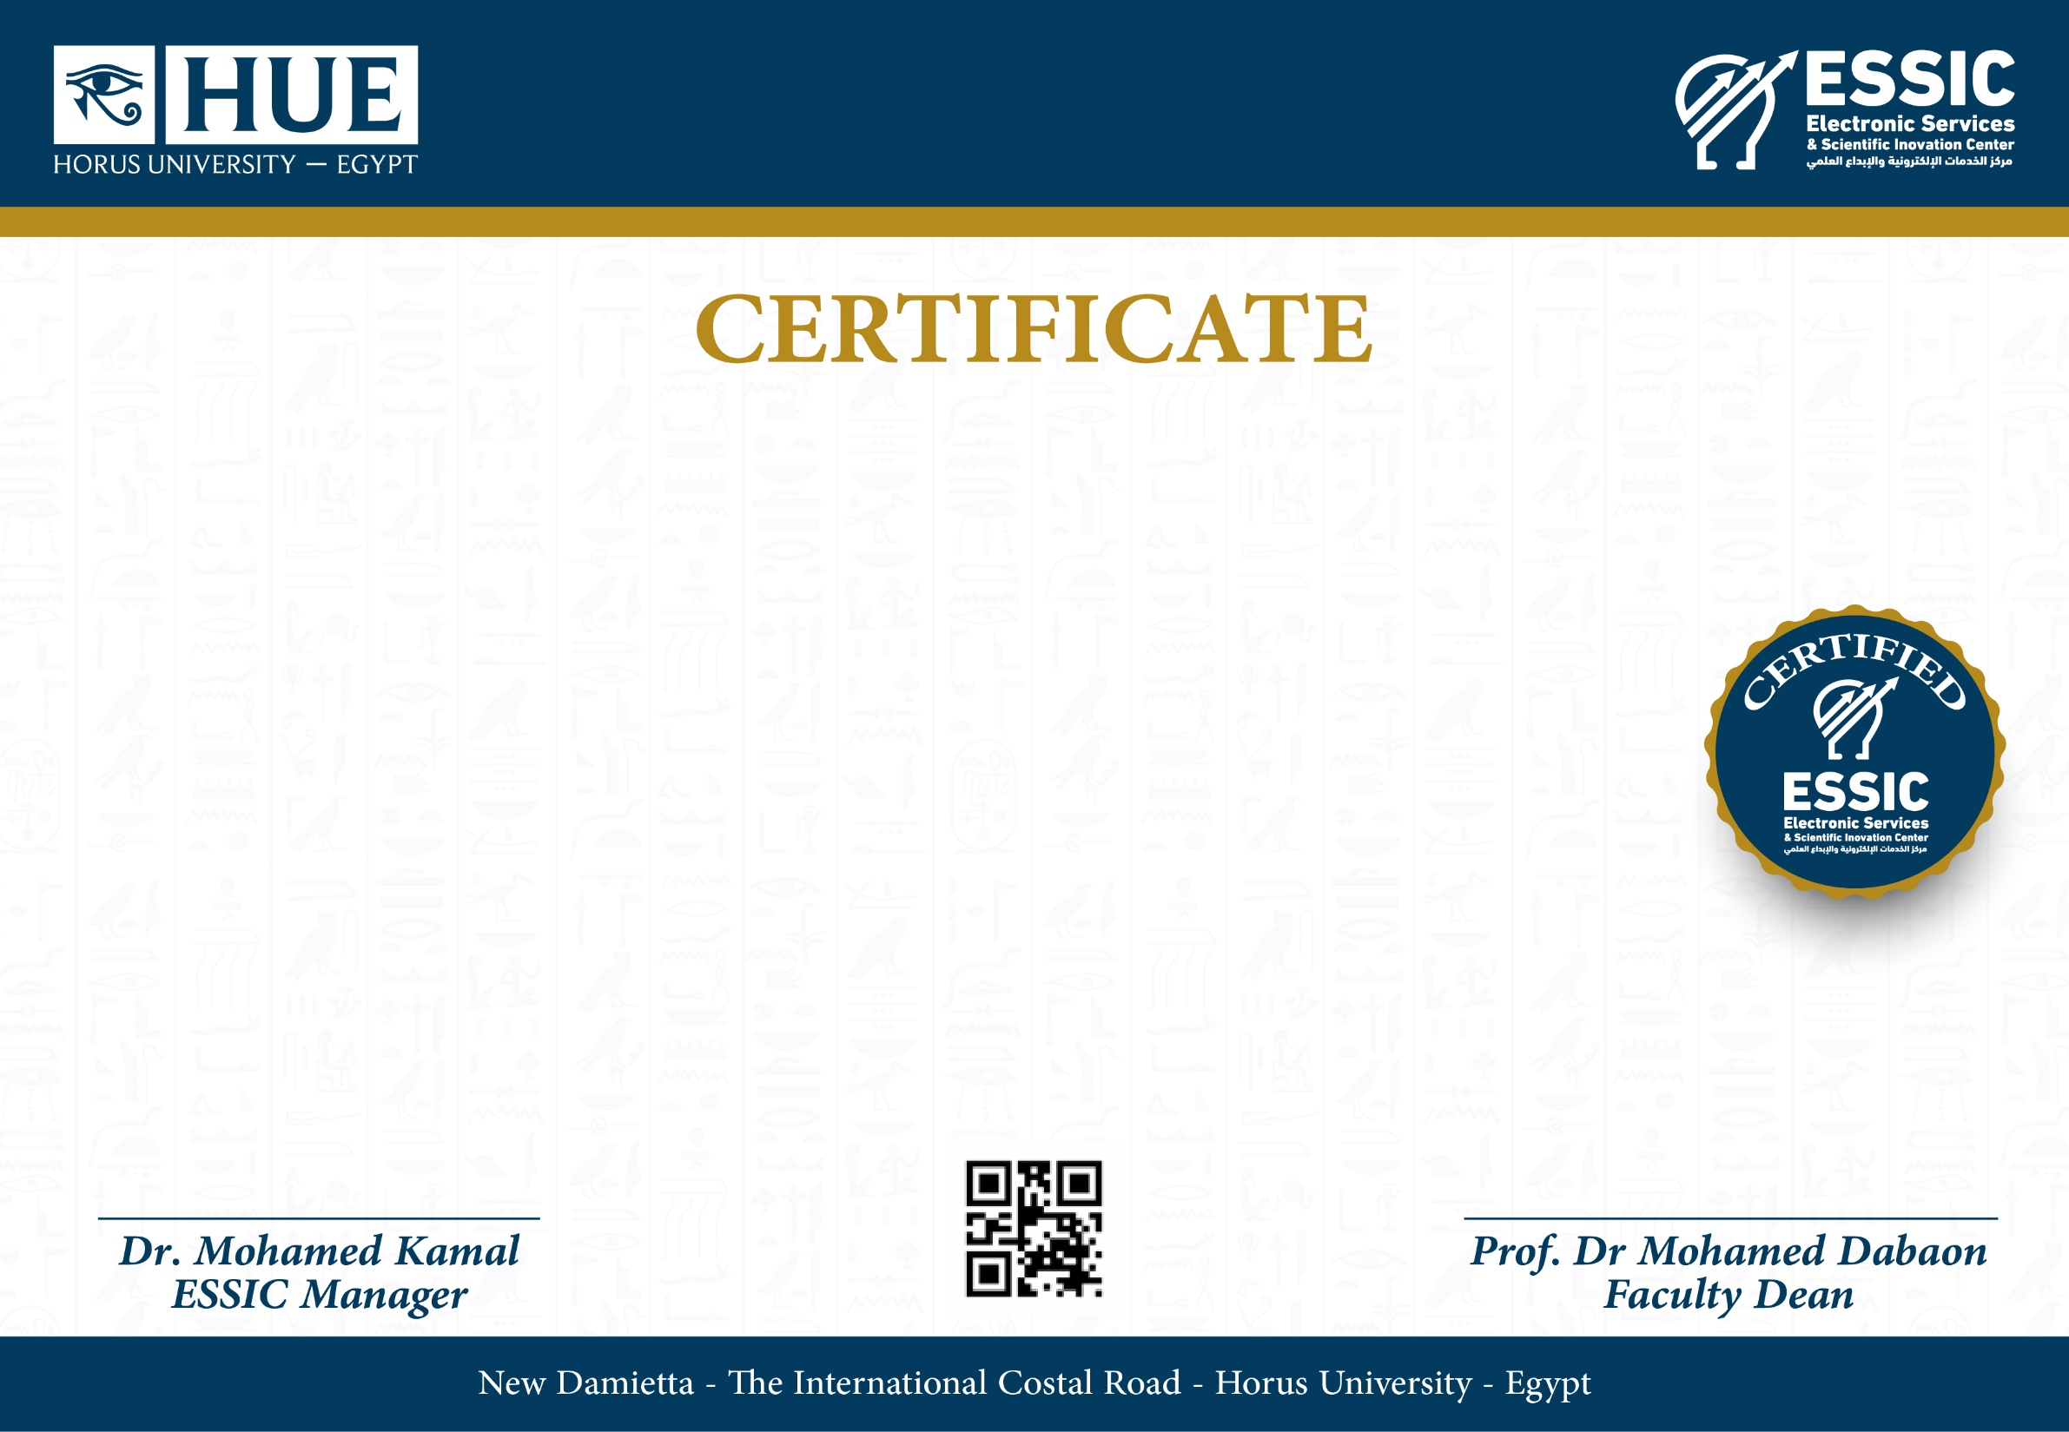
This certificate is proudly presented to :
Hossam Elbadry
From Horus Ambassadors Team
For organizing the introductory seminar of Communication Dept.
in Horus University - Egypt on Wednesday 25 August 2021

Slide 2
This certificate is proudly presented to :
Abdelghfar Elmowafy
From Horus Ambassadors Team
For organizing the introductory seminar of Communication Dept.
in Horus University - Egypt on Wednesday 25 August 2021

Slide 3
This certificate is proudly presented to :
Abdelrahman abu-Elkasem
From Horus Ambassadors Team
For organizing the introductory seminar of Communication Dept.
in Horus University - Egypt on Wednesday 25 August 2021

Slide 4
This certificate is proudly presented to :
Karim Yasser
From Horus Ambassadors Team
For organizing the introductory seminar of Communication Dept.
in Horus University - Egypt on Wednesday 25 August 2021

Slide 5
This certificate is proudly presented to :
Yasser Elhadidy
From Horus Ambassadors Team
For organizing the introductory seminar of Communication Dept.
in Horus University - Egypt on Wednesday 25 August 2021

Slide 6
This certificate is proudly presented to :
Mohamed Dora
From Horus Ambassadors Team
For organizing the introductory seminar of Communication Dept.
in Horus University - Egypt on Wednesday 25 August 2021

Slide 7
This certificate is proudly presented to :
Mohamed Elhosiny
From Horus Ambassadors Team
For organizing the introductory seminar of Communication Dept.
in Horus University - Egypt on Wednesday 25 August 2021

Slide 8
This certificate is proudly presented to :
Waleed Elagmey
From Horus Ambassadors Team
For organizing the introductory seminar of Communication Dept.
in Horus University - Egypt on Wednesday 25 August 2021

Slide 9
This certificate is proudly presented to :
Hassan Abdelall
From Horus Ambassadors Team
For organizing the introductory seminar of Communication Dept.
in Horus University - Egypt on Wednesday 25 August 2021

